Slide 1
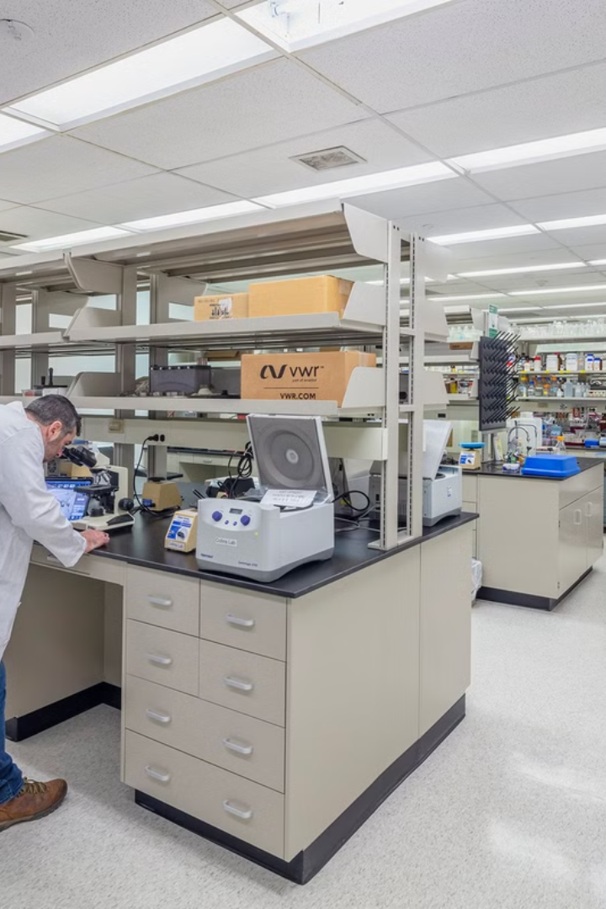
Lab Inventory Management system
This presentation explores a comprehensive solution for optimizing lab inventory management through a user-friendly web and mobile application
Group no - 01
s15984 - Raveen Adhikari
s16013 - Thilina Chandrasekara
s16039 - Hashani Kulathunga
s16041 - Kalani Keshila
page 1

Slide 2
Problems with Manual Inventory
Inaccurate Records
Time-Consuming
Lost Records
Missing Components
Manual inventory often suffers from inconsistencies, leading to inaccurate data and difficulties tracking items
Its very time consuming to find a object in a lab .
Written records can be destroyed by various reasons
Some component will not be able to locate
page 2

Slide 3
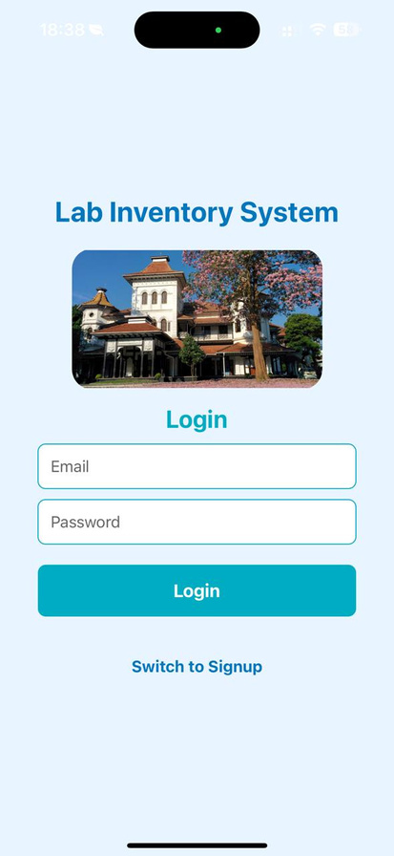
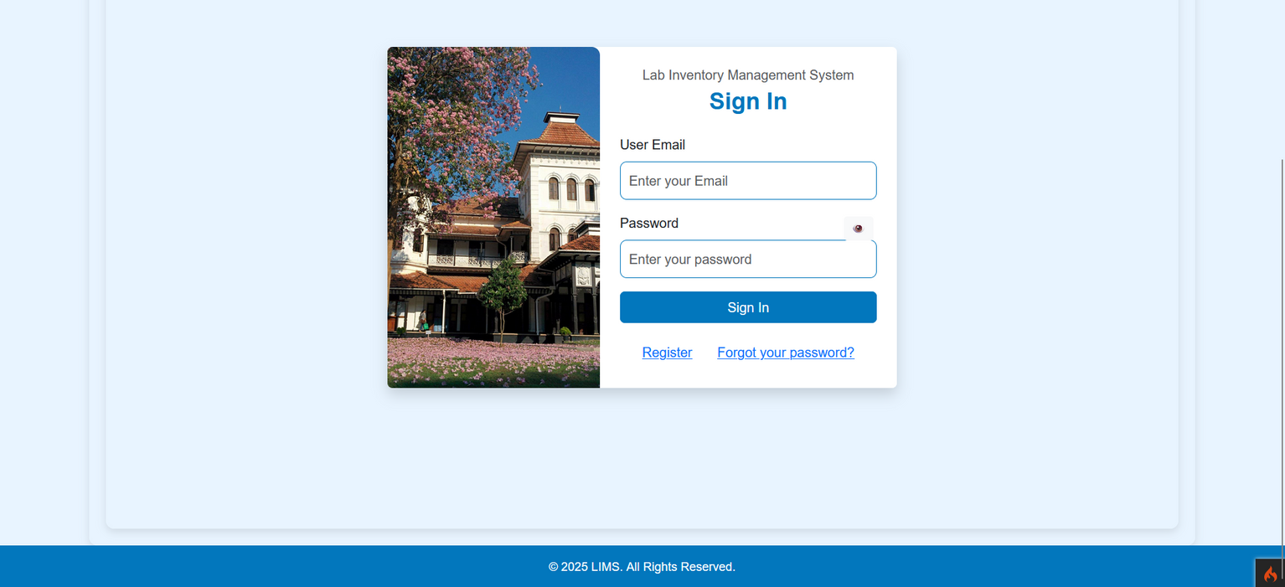
OUR SOLUTION
Mobile App
Web Application
page 3

Slide 4


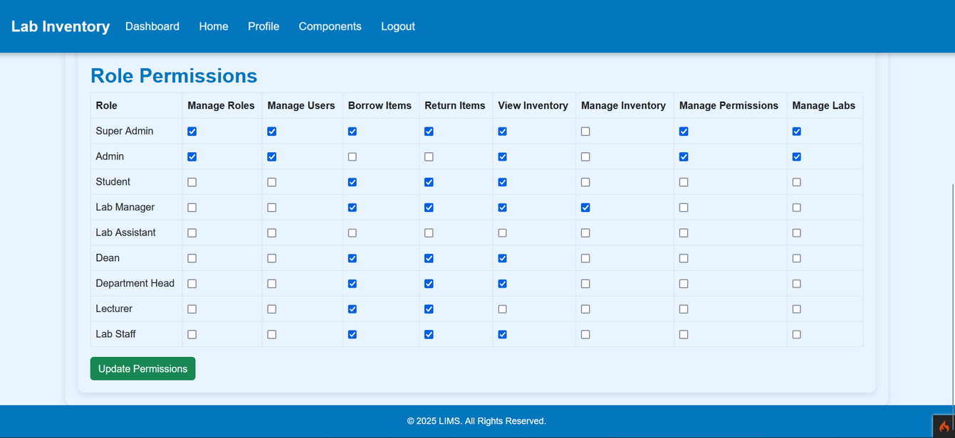
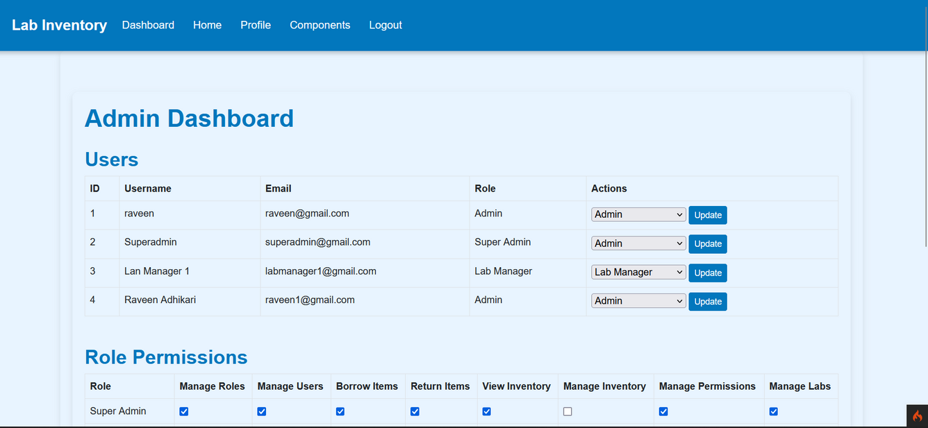
Admin dashboard
Centralized Control
Update User Roles
Manage Permissions
manage Users
page 4

Slide 5

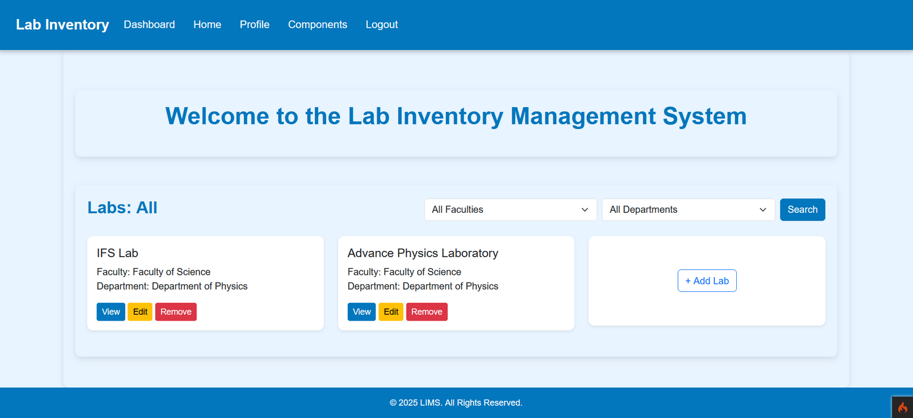
Homepage
Filter Labs By Faculty and Department
Manage labs (for Admins)
page 5

Slide 6

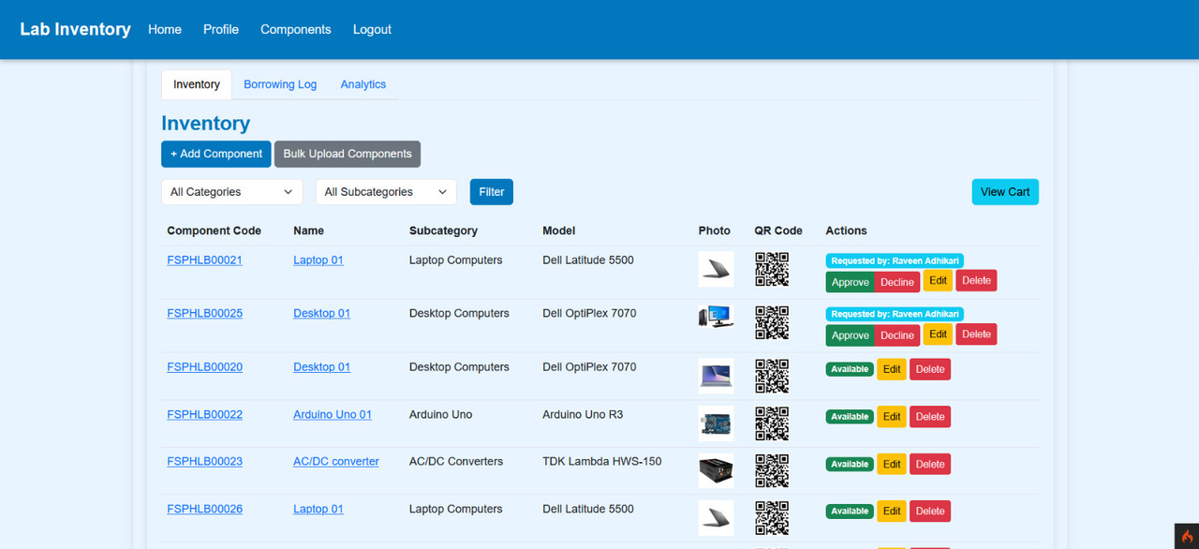
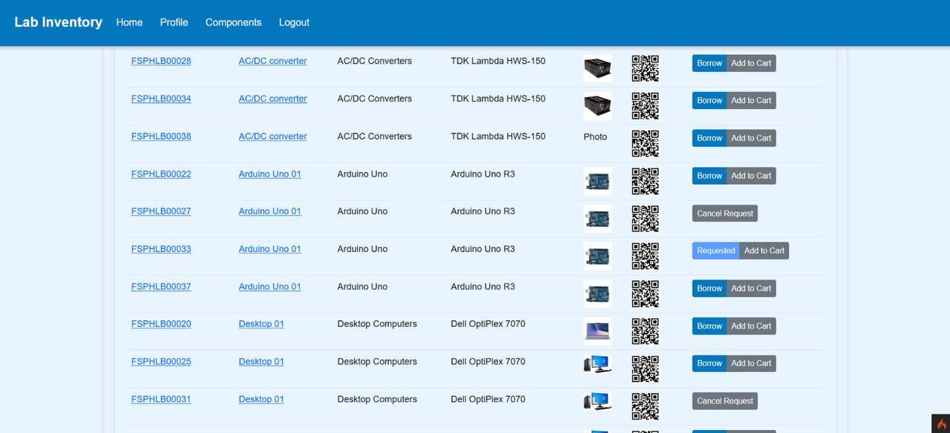
Inventory
page 6

Slide 7
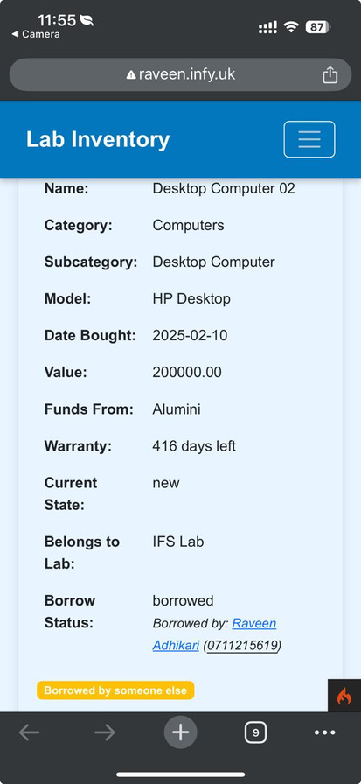
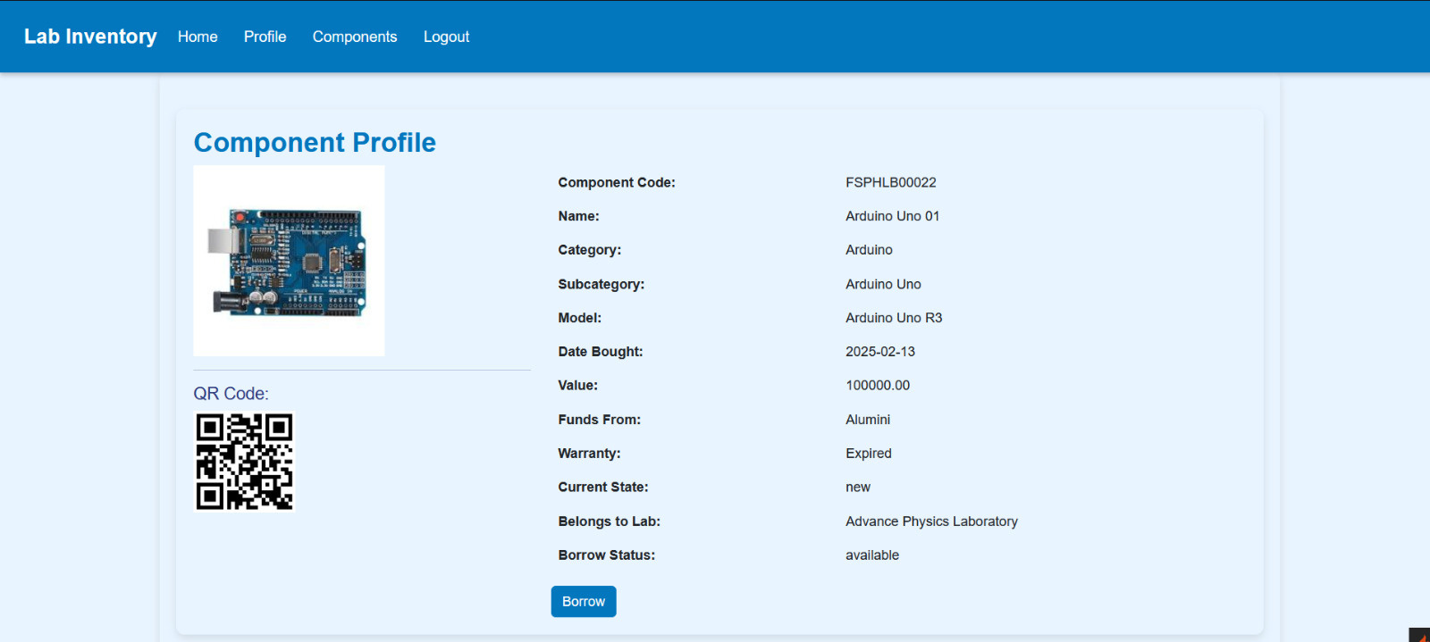
Component Profile
If the QR code is scanned by a webcam or an external camera, the detailed view will be displayed.
page 7

Slide 8
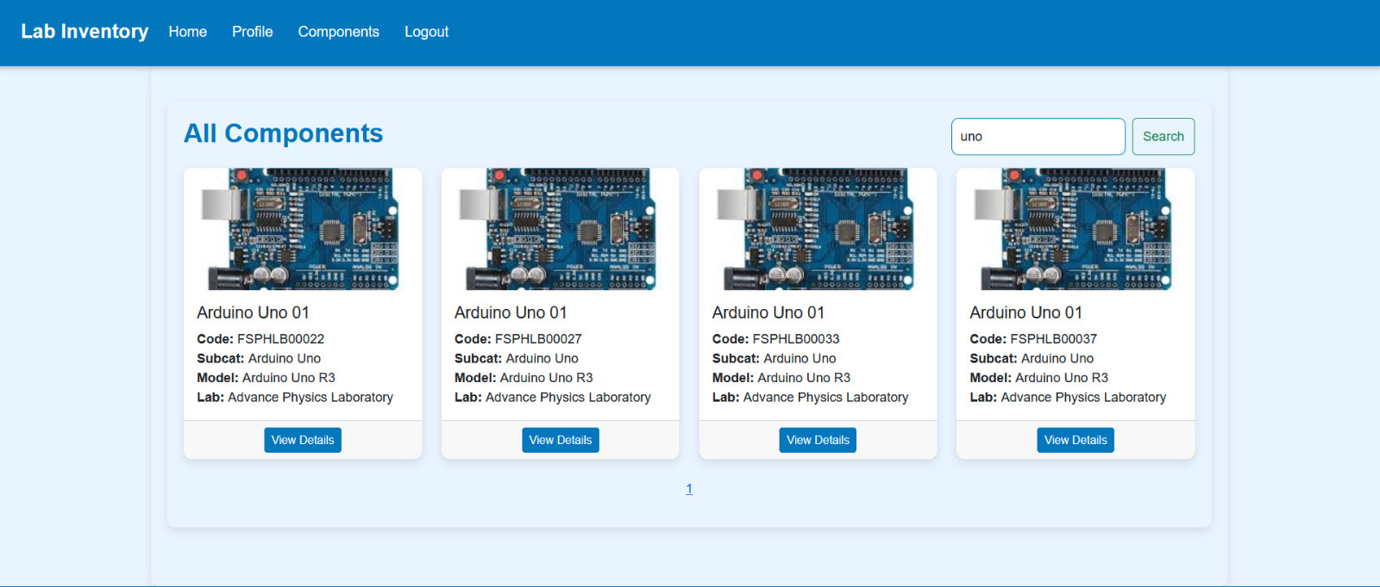
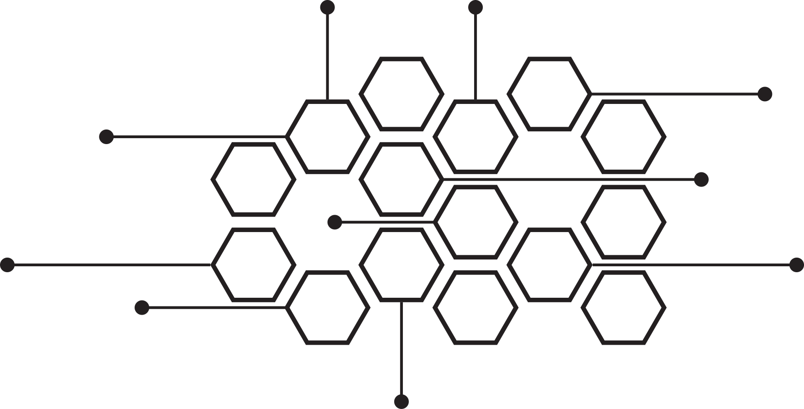
Search components
page 8

Slide 9
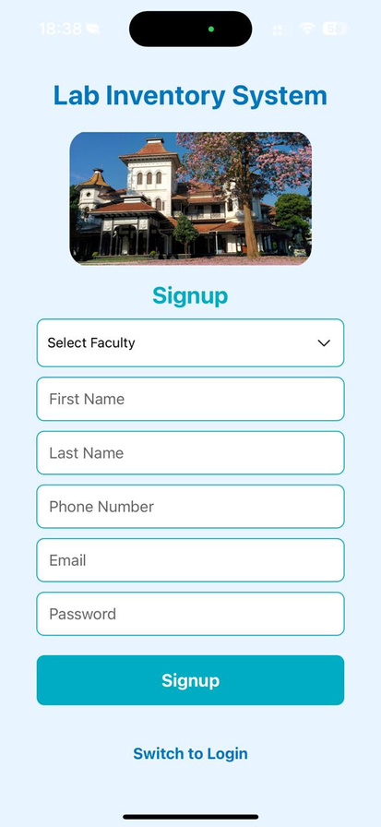
MOBILE APP
Login page
SignUp page
Drop down menu for easy navigation and faculty selection.
page 9

Slide 10
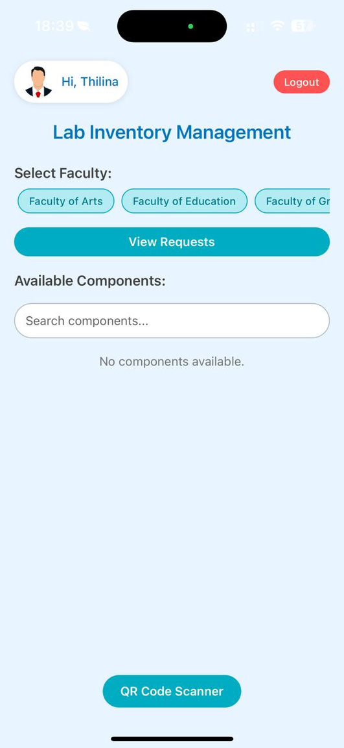
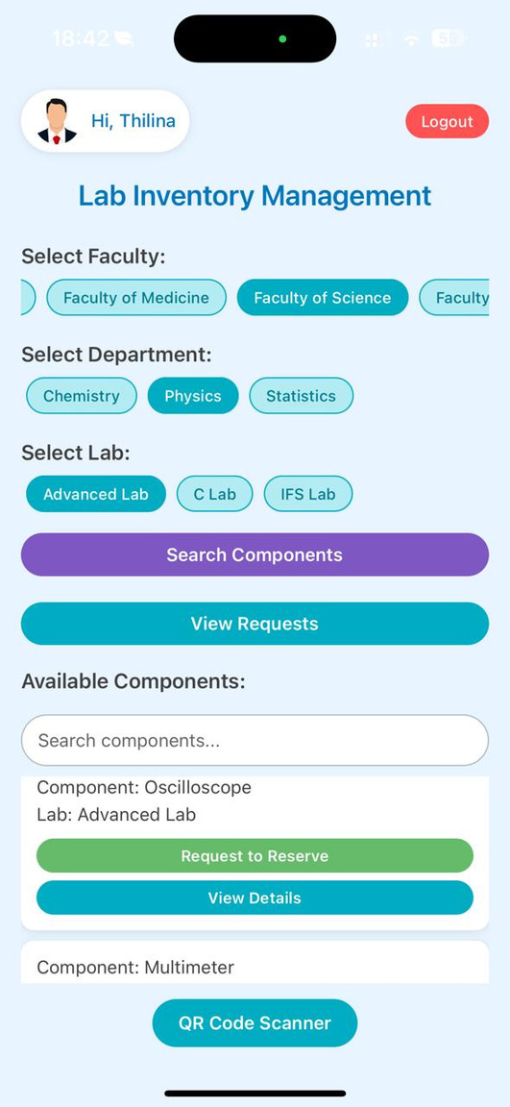
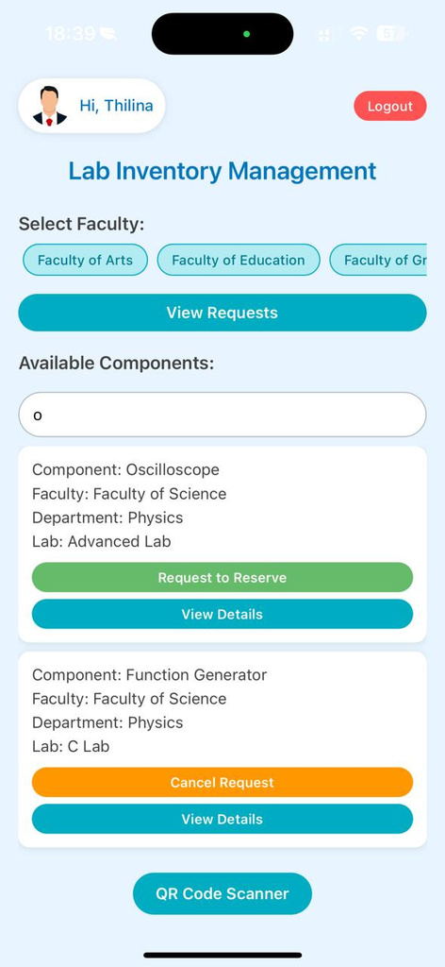
page 10
HOME PAGE
User-friendly interface.
can access to every lab in the university regardless of the faculty.
can search components all across the university.

Slide 11
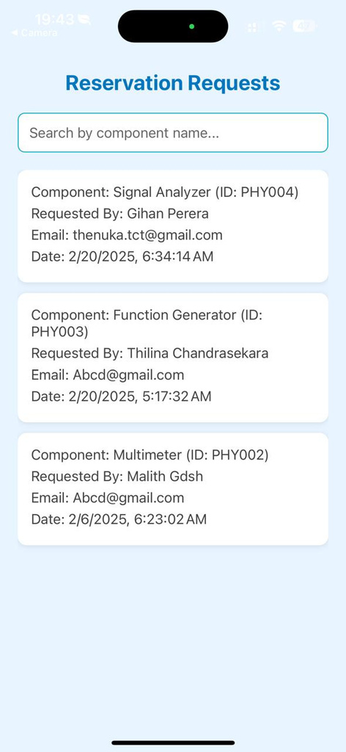
RESERVATION REQUESTS
Can view the details of the person who reserved the item before you, which will be useful in an emergency situation.
page 11

Slide 12
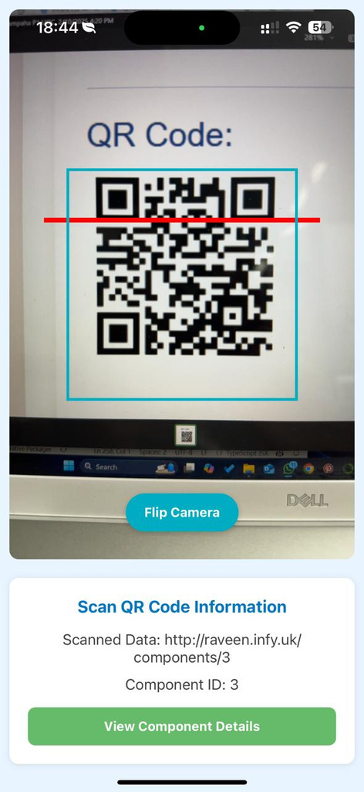
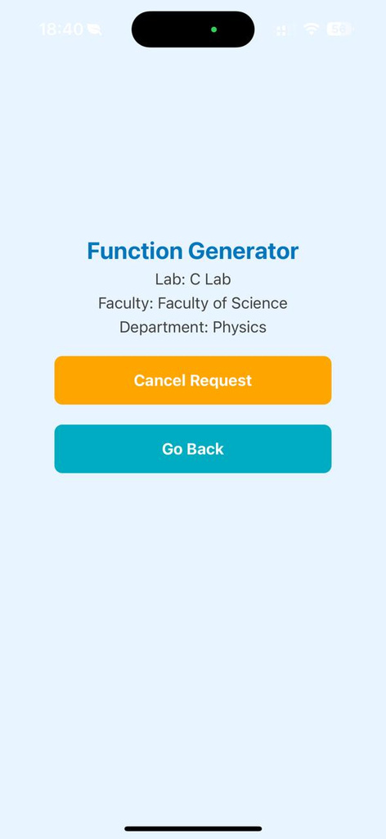
QR SCANNER
QR scanner
Detailed View
page 12

Slide 13
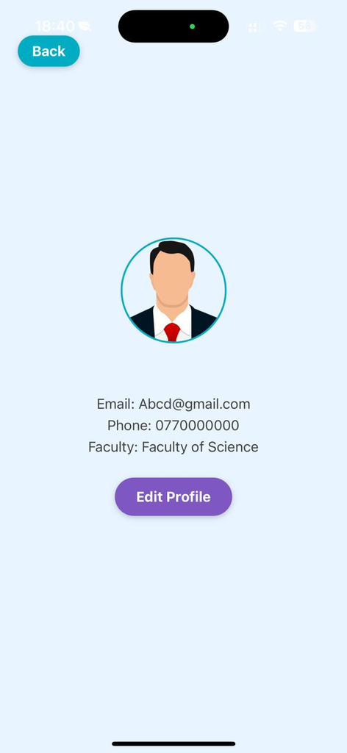
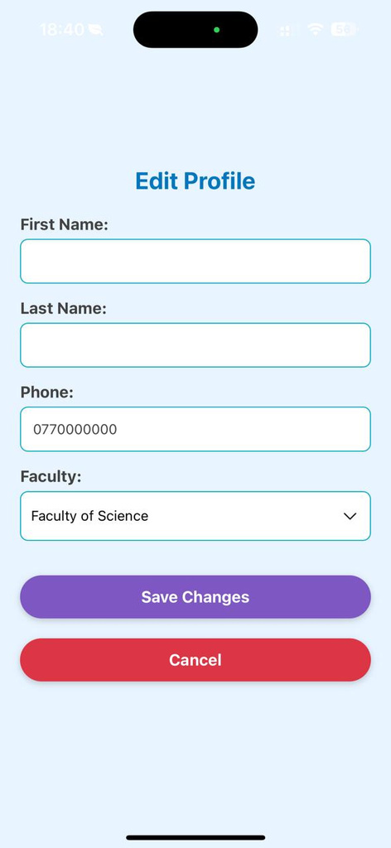
USER PROFILE
Drop down menu for easy navigation and faculty selection.
page 13

Slide 14

PROJECT BENEFITS
Eliminates the need for manual logbooks, saving time and reducing human errors and Speed up the process of borrowing, returning, and tracking lab items.
Simplify the process of assigning, tracking and managing lab resources.
Enable inter-departmental access to check the availability of items across labs.
Ensures that only authorized personnel can access or modify inventory data.
Allows users to check item availability across various labs and departments, promoting resource sharing.
page 14

Slide 15

FUTURE IMPROMENTS
Provide real-time tracking and notifications for borrowed items when the borrowed time is exceeded.
Provide facilities with the ability to transfer items across labs, departments, and faculties.
page 15

Slide 16

THANK YOU!

